Slide 1
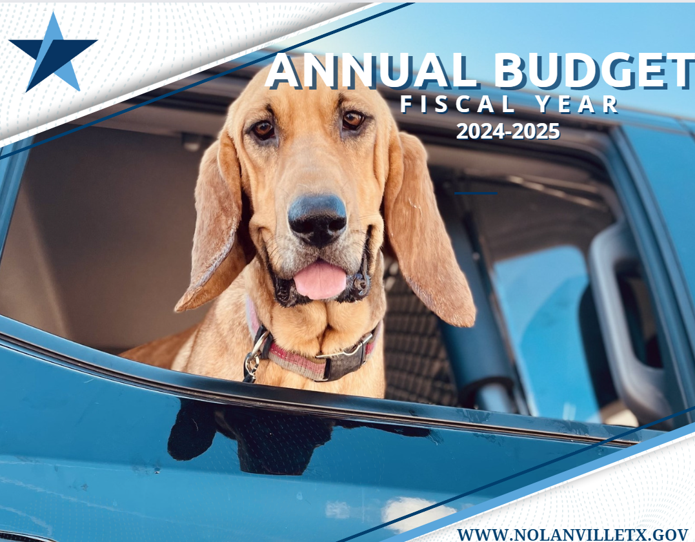
State of the City
Budget Summary
FY 2024-2025

Slide 2
FY 24-25 Calculated Rates
No New Revenue Total Tax Rate: .4779
Voter Approval Total Tax Rate: .5018
Di minimis Total Tax Rate: .5858
No New Revenue M&O Rate: .4073
Voter Approval M&O Rate: . 4215
Interest & Sinking Rate: .0803
Proposed Rate for FY 24-25
Total Tax Rate 0.5017 per $100
Taxable Value $508,696,976
  Maintenance & Operations (M&O)- 0.4214
  Interest & Sinking (I&S) Debt Service- 0.0803
"This budget will raise more revenue from property taxes than last year's budget by an amount of $249,660, which is a 10.87% percent increase from last year's budget. The property tax revenue to be raised from new property added to the tax roll this year is $210,675."
Maintenance & Operations (M&O) Tax Rate is the tax
rate that is needed to raise the same amount of taxes
that the taxing unit levied in the prior year plus the
applicable percentage by law. The rate accounts for such
things as salaries, utilities and day-to-day operations.
Interest & Sinking (I&S) pays debt service for Capital Improvements.

Slide 3

Budget Comparison Information
 | 2022-2023 Approved | 2023-2024 Approved | 2024-2025 Proposed | Increase (Decrease) | Percentage Change
Total Budget | $2,769,767 | $3,519,454 | $3,785,783 | $266,329 | 7.57%
Property Tax Budget
M&O Maintenance & Operations | $1,282,633 | $1,889,320 | $2,143,649 | $254,329 | 13.46%
I&S Debt Service | $390,252 | $404,006 | $408,669 | ($4665) | (1.15%)
Total | $1,672,885 | $2,293,326 | $2,552,318 | $249,660 | 10.87%
Last Years Property Tax Rate .4979
This year’s property tax rate .5017
Difference: 4.98% Increase in rate
Tax Year | General Fund M&O | Debt Service I&S | Total
2023 | 0.4138 | 0.0841 | 0.4979
2022 | 0.3961 | 0.1036 | 0.4441
2021 | 0.3463 | 0.1211 | 0.4674
2020 | 0.3700 | 0.1603 | 0.5303
2019 | 0.4036 | 0.1120 | 0.5156
2018 | 0.4065 | 0.1200 | 0.5262
2017 | 0.3777 | 0.1222 | 0.4999
2016 | 0.3878 | 0.1142 | 0.5020
2015 | 0.3781 | 0.1273 | 0.5054
2014 | 0.3635 | 0.1419 | 0.5054
2013 | 0.3650 | 0.1468 | 0.5118
2012 | 0.3654 | 0.1541 | 0.5195
2011 | 0.3454 | 0.1240 | 0.4694
2010 | 0.3134 | 0.1326 | 0.4460
2009 | 0.2880 | 0.2197 | 0.5077
Tax Rate Comparisons
Neighboring Cities
City | Proposed FY 25 Total Rate
Nolanville | .5017
Harker Heights | .5300
Belton | .5225
Temple | .6267
Killeen | .6573
Copperas Cove | .6610
"This budget will raise more revenue from property taxes than last year's budget by an amount of $249,660, which is a 10.87% percent increase from last year's budget. The property tax revenue to be raised from new property added to the tax roll this year is $210,675."
Tax Rate Range over last 14 years:
.4441 - .5303
This required statement compares the No New Revenue Amount to the proposed tax rate. The next amount reflects the amount of that increase that is from new property.

Slide 4
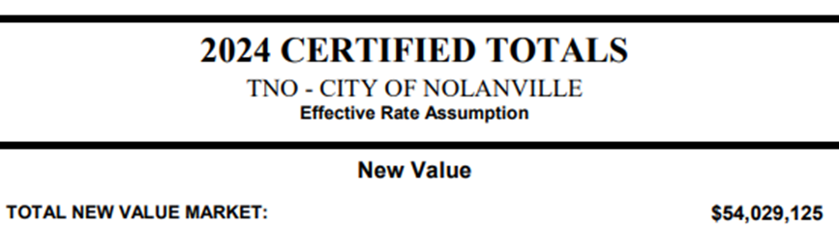
2024 CERTIFIED TAX ROLL
SUMMARY
2024 Taxable Value: $574,382,224
Last Year Taxable Value: $492,338,542
2024 Total New Improvements: $42,060,303
-New Loses: $11,508,687
Last Year Total New Improvements: $51,368,614
  -New Loses: $6,776,182
2024 Adjusted Values Taxable: $508,696,976
2023 Adjusted Value: $456,578,012
2022 Adjusted Value: $376,691,128
2021 Adjusted Value: $302,501,542
2020 Adjusted Value: $253,092,964
Record vote on tax rate adoption ordinance. The motion to adopt a tax rate that exceeds the no-new revenue tax rate must be made precisely as follows: “I move that the property tax rate be increased by the adoption of a tax rate of .5017, which is effectively a 4.98% percent increase in the tax rate.”
2024 Total Exemptions: $220,385,434
Last Year Total Exemptions: $177,733,530
NNR Rate: .4779
Proposed: .5017

Slide 5
PERSONNEL PRIORITIES
Personnel | 2017-2018 | 2018-2019 | 2019-2020 | 2020-2021 | 2021-2022 | 2022-2023 | 2023-2024 | 2024-2025
City Manager | 1 | 1 | 1 | 1 | 1 | 1 | 1 | TBD
City Secretary | 1 | 1 | 1 | 1 | 1 | 1 | 1 | 1
Finance Director | .5 | * | * | * | * | * | * | *
Admin. Assistant | 1 | 1 | 1 | 1 | 1 | 1 | 1 | 2
Community Outreach |  |  |  |  | 1 | 1 | 1 | 1
Court Clerk | 1 | 1 | 1 | 1 | 1 | 1 | 1 | 1
Police Chief | 1 | 1 | 1 | 1 | 1 | 1 | 1 | 1
Police Admin | 0 | * | 1 | 1 | 1 | 1 | 1 | 1
Police Officers | 7 | 8 | 9 | 9 | 10 | 10 | 10 | 10
Public Works DR | 1 | 1 | 1 | 1 | 1 | 1 | 1 | 1
Public Works Labor | 1 | 1 | 2 | 2 | 2 | 3 | 5 | 4
Planning Coordinator |  |  |  |  | 1 | 1 | 1 | 1
Seasonal Labor | * | * | * | * | * | * | * | *
Inspectors |  | * | * | * | * | * | * | *
Fire Chief |  |  |  |  |  |  | 1 | 1
Fire Fighters |  |  |  |  |  |  | * | *
Total Full Time Personnel | *15.5 | *16 | *18 | *18 | *21 | *22 | *25 | *24
*Part Time not counted in total, personnel
in this category do not receive healthcare
or retirement benefits.
*Fire Department Salary increased by $154,000 budget amendment F03-24, this amount is not in the original salary total.

Slide 6
Sevices & Budget
Internal Assets
Police
Fire & Rescue
Planning & Zoning
Special Projects
Economic Development
Code Enforcement
Public Works
Streets & Drainage
Parks & Recreation
Animal Control
Administration
Finance
Court
Contract Services
Trash
Emergency Medical Service
Legal
Planning
Engineer
Information Technology
Water & Waste Water service are provided by Politically Separate Water Districts.

Slide 7
FY 2024-2025
Revenue Forecast &
Budget

Slide 9
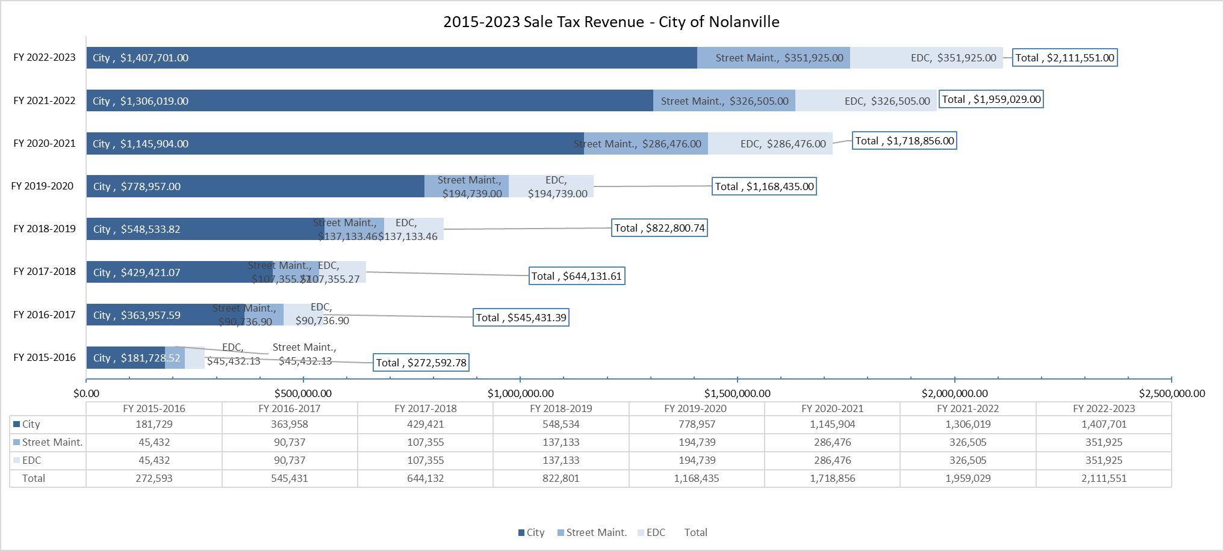
SALES TAX

Slide 10
Debt service interest & sinking (I&S) Rate

Slide 11
Debt Service
The City’s outstanding indebtedness will be $ 2,725,000 as of October 1, 2024. Interest and Sinking (I&S) is collected from property tax revenue and pays the principal, interest, and fees on the current debt.
September of 2016, the City consolidated the 2007 Series Bond and 2012 Certificate of Obligation to take advantage of low interest rates and secured a 1.73% refinanced bond with Chase.
Council approved a 7-year Tax Note at 2.07% from BBT in March 2017 to complete several road repair and drainage issues. Retired March 2024.
Council approved bond financing for capital improvement projects in July 2020 for $1.5 mil at 1.68% for 15 years (Callable) for Capital Infrastructure Improvements.
Council approved financing from the TxDOT State Infrastructure Bank to fund July 2023 for $1 mil to fund the match and potential overmatch requirements for Old Nolanville Road Bridge Project. The Loan is Callable at anytime interest rate is 4.08% for a payback period 15 years. Unused funds can be returned at the conclusion of the project.
Description of Debt Service | Principal or Contract Payments to be Paid | Interest to be Paid | Total Payments
General Obligation Refunding Bonds Series 2016, Chase | $190,000 | $10,208 | $200,208
Tax Note (7 Year) Series 2017, BBT
General Obligation 2020, Chase | $95,000 | $18,29 | $113,291
State Infrastructure Bank 2023, SIB | $54,370 | $40,800 | $95,170
Retired 2024
TOTAL FY 2024-2025 Payment: $408,669
Interest & Sinking Rate (I&S): $.0803
LAST YEAR: 0.0841
Payment FY 23-24: $384,031
Payment FY 22-23: $390,298
Payment FY 21-22: $396,564

Slide 12
Timeline
Debt Service
Refinance Bond
$1.9 M
Combined
2010 10th Street & 2012 Ave H
7 Year Tax Note
$500,000
Plaza/Red Leaf Drainage
2020 Bond
$1.5 M
Retired- 7 year Note
Retired
Refinanced Bond
2016
2017
2020
2024
2027
2023 SIB
$1 Mil
ONR Bridge
Propose projects from CIP

Slide 13
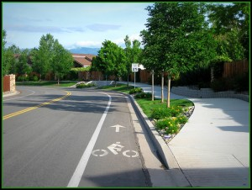
CAPITAL INFRASTRUCTURE Plan (CIP)
&
Capital Outlay

Slide 14
FY 24-25 Project List
ITEM | Department | Strategy/Provision | Cost
Public Safety Facility | Fire Department | Strategy was revised to gain former volunteer Fire Department Building and conduct renovation plans during FY 24-25. | $475,572 Professional Services as a transfer in from general fund or reserve Consider an additional amount for increment improvements while awaiting larger bond implementation.
Facility Expansion SMART Museum BGCA / Park Gymnasium Indoor Recreation Area | Parks & Recreation | Fund Professional Service to carry out construction plans and start the Facility Bond process to take the place of retired 2016 Bond. Apply for TPWD grant 2025 | $160,000 Professional Services as possible transfer in or include with bond package.
Railroad Siding Relocation Reduce blocking of intersections QUIET ZONE Completion | Public Works | Applied for KTMPO - TxDOT Funding and Railroad Elimination Grant. Application funded in FY 23-24. Phasing improvements with KTMPO grant for Jackrabbit and Pleasant Hill Crossing. This will complete the Quiet Zone | 20% Match and 100% Engineering Project cost is at least $5,000,000 KTMPO Grant for next phase $1,000,000
Combined Large Park Project | Parks & Recreation | Apply for TPW grant funding summer 2025 and implement with normal park outlay operational budget, increase this line item incrementally in subsequent years to support larger grant submission that includes trail and 5 pocket parks. | $1,500,000 split for multi year implementation. Consider funding part of the City Match requirement with Facility Bond Package.
Warriors Path Improvements | Public Works | Reconstruction and widening of Warriors Path with anticipation of connection with I14. KTMPO for TxDOT Funding. | Partnering with Harker Heights to widen Warriors Path. Preliminary engineering will need to be completed for cost. FY28
10th Street Tributary Construction | Public Works | Utilize TCEQ 319 grant for $150,000 towards construction, allocate regular Public Works Street Maintenance towards the remainder. | Preliminary engineering with cost will be completed FY 2025

Slide 15
  Capital Improvement Plan
  Project List 2024 – 2030
  Tax Increment
  Reinvestment Zone added to Plan

Slide 16
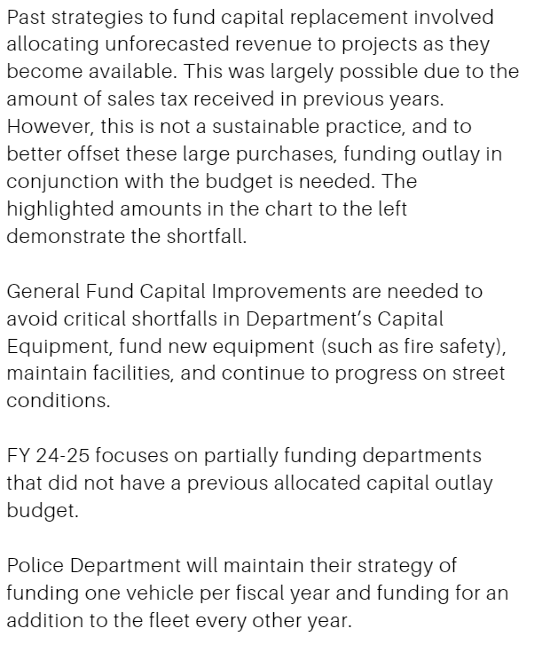
Capital Outlay By Department
GENERAL FUND CAPITAL REPLACEMENT PROGRAM
 |  |  |  |  |  | Original
 |  | # of |  |  |  | or Last
 |  | Units |  |  |  | Original
 | Service | In | Item | Cost/ | 2024-2025 | Purchase
Item by Department | Life | Dept. | Cost | Year | Budget | Year
ADMINISTRATION
Toyota, Sienna miles: 52,856 | 10 | 1 | $23,000 | $2,300 |  | 2017
File Server | 5 | 2 | $22,000 | $8,800 | $0 | 2017
TOTAL |  |  | $45,000 | $11,100 | $0
PUBLIC WORKS
John Deere 790 Tractor | 10 | 1 | $38,000 | $3,800 |  | 2000
Mower, Zero Turn, SCAG 61" | 7 | 2 | $12,000 | $3,429 |  | 2022
Mower, Zero Turn, SCAG 48" | 7 | 1 | $6,600 | $943 |  | 2018
16' C&M Utility Trailer | 15 | 1 | $3,000 | $200 |  | 2005
Utility Trailer Dump 14FT | 15 | 1 | $6,000 | $400 |  | 2000
Utility Trailer Dump 16FT | 15 | 1 | $15,000 | $1,000 |  | 2021
Dodge, Ram 2500: 25,723 | 10 | 1 | $45,000 | $4,500 |  | 2020
Dodge Ram 1500; miles 38,240 | 7 | 1 | $28,000 | $4,000 | $12,000 | 2019
F150; miles 110,463 | 7 | 1 | $25,000 | $3,571 |  | 2007
F250; miles 81,925 | 7 | 1 | $25,000 | $3,571 |  | 2011
SALSCO Paver | 20 | 1 | $50,000 | $2,500 |  | 2022
Skid Steer w/accessories | 20 | 1 | $100,000 | $5,000 |  | 2022
Mahindra Tractor 4530 w loader | 10 | 1 | $55,000 | $5,500 |  | 2006
Backhoe CAT 420E | 20 | 1 | $70,000 | $3,500 |  | 2010
TOTAL |  |  | $478,600 | $41,914 | $12,000
PUBLIC SAFETY
Chevy Silvarado 6500 Brush: miles 4239 | 10 | 1 | $250,000 | $25,000 |  | 2020
International-Terra Star (2014) | 10 | 1 | $250,000 | $25,000 |  | 2023
Command Vehicle | 5 | 1 | $45,000 | $9,000 |  | 2014
Type III Fire Engine | 10 | 1 | $330,000 | $33,000 |  | 2006
Ambulance (TBD) |  |  |  |  | $25,000
Freightliner Pumper (1996) (backup) | 5 | 1 | $100,000 | $20,000 |  | 2023
TOTAL |  |  | $975,000 | $187,057 | $25,000
POLICE
File Server | 5 | 2 | $22,000 | $4,400 |  | 2020
Patrol Vehicles | 5 | 8 | $65,000 | $104,000
Ford Explorer 19-03 (2019); miles 100,612 |  |  |  |  |  | 2019
Ford Explorer 17-05 (2017); miles 158,319 |  |  |  |  | $70,000 | 2017
Ford Explorer 17-09 (2017); miles 59,882 |  |  |  |  |  | 2017
Chevy Tahoe 18-20 (2020), miles 54,675 |  |  |  |  |  | 2020
Ford Inter Sedan 19-06 (2019); miles 46,651 |  |  |  |  |  | 2019
Ford Crown Sedan (2008); miles 35,000 |  |  |  |  |  | 2021
Chevy Silverado 21-01 (Code) (2021) miles 11,672 |  |  |  |  |  | 2021
Ford Explorer Hybrid 22-02 (2021): miles 12,574 |  |  |  |  |  | 2021
TOTAL |  |  | $87,000 | $108,400 | $70,000
GRAND TOTAL |  |  | $610,600 | $348,471 | $107,000
Note: Item cost does not reflect the amount of purchase at the time it was acquired, it is determined by replacement cost. Highlighted area demonstrates the shortfall in Capital Replacement Funding Strategy.

Slide 17
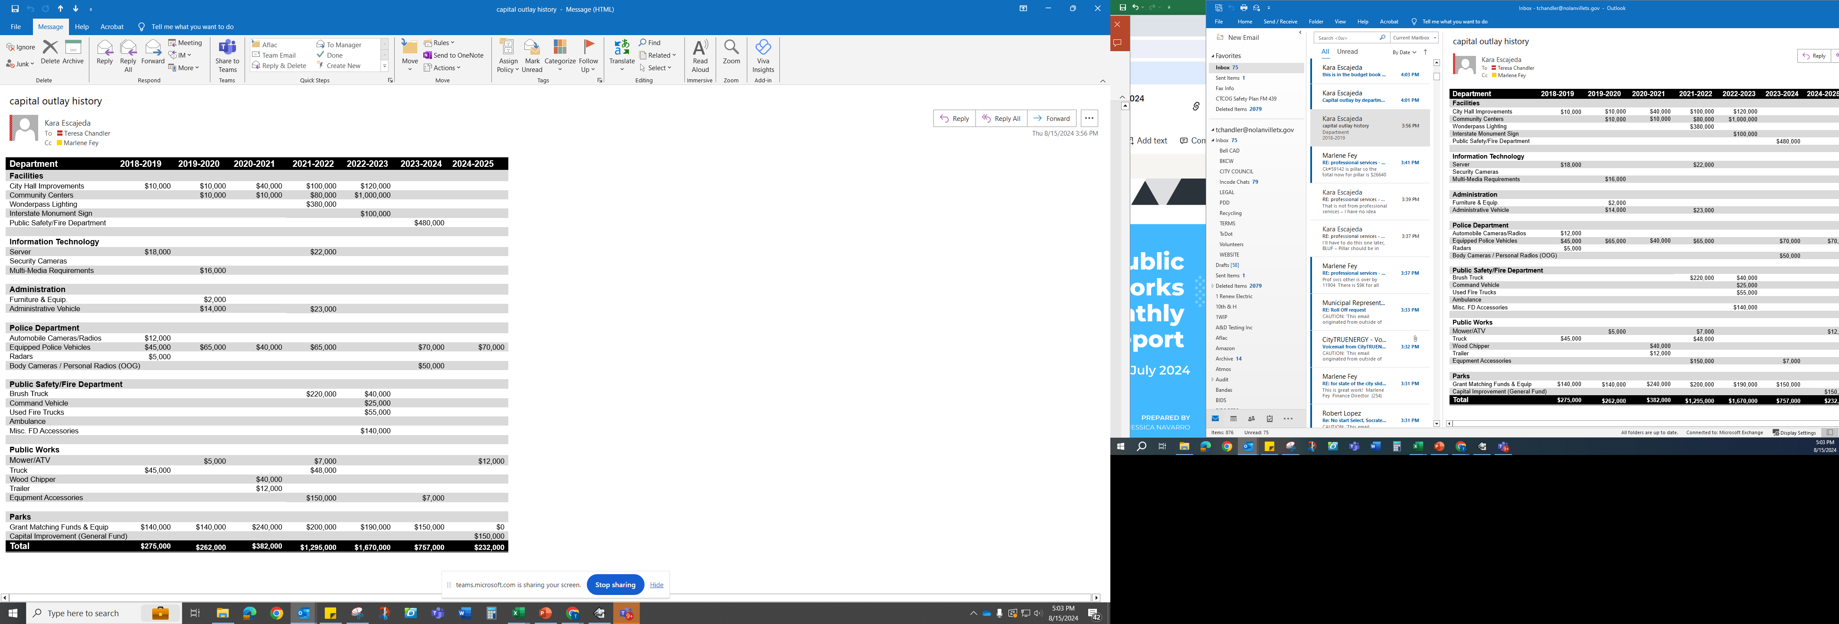
Capital Outlay Strategy
Priority is expanding Public Safety
capability internally.
Start Bond process for combined Facility
Utilizing combination of TIRZ funding
& Ad Valorum Tax.
Complete Fox Park with allocated
Operational Capital Outlay & TPW
Grant Funding.
Apply for Grant Funding for the following:
Large Park Grant split between Wildwood,
Pecan Park, Meyers Park Donation, and
The ENCLAVE/School pocket park.
Incremental Improvements to City Hall
Through facilities operational budget (AC
Replacementnt.

Slide 18
Past year’s accomplishments
2021-2022

Slide 19
Thank You

